Slide 1
Monocots II
Commelinid Clade
J&C pp 293-323

Slide 2
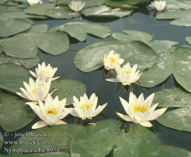
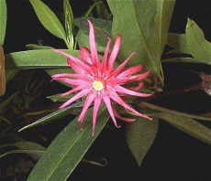
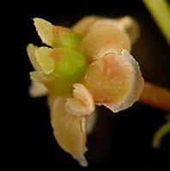
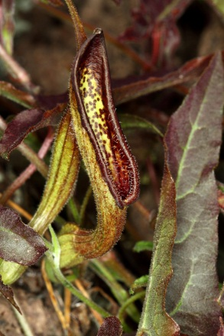
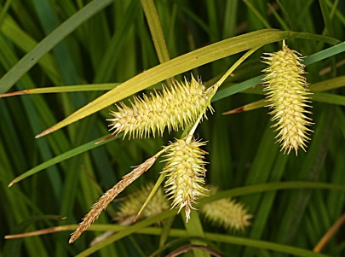
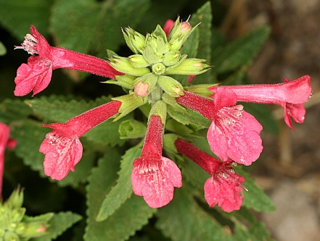
Amborella
Nymphaeales
Austrobaileyales
Monocots
Magnoliids
Eudicots
ANA Grade
Remember the big picture….
Angiosperm Relationships
(simplified)

Slide 3
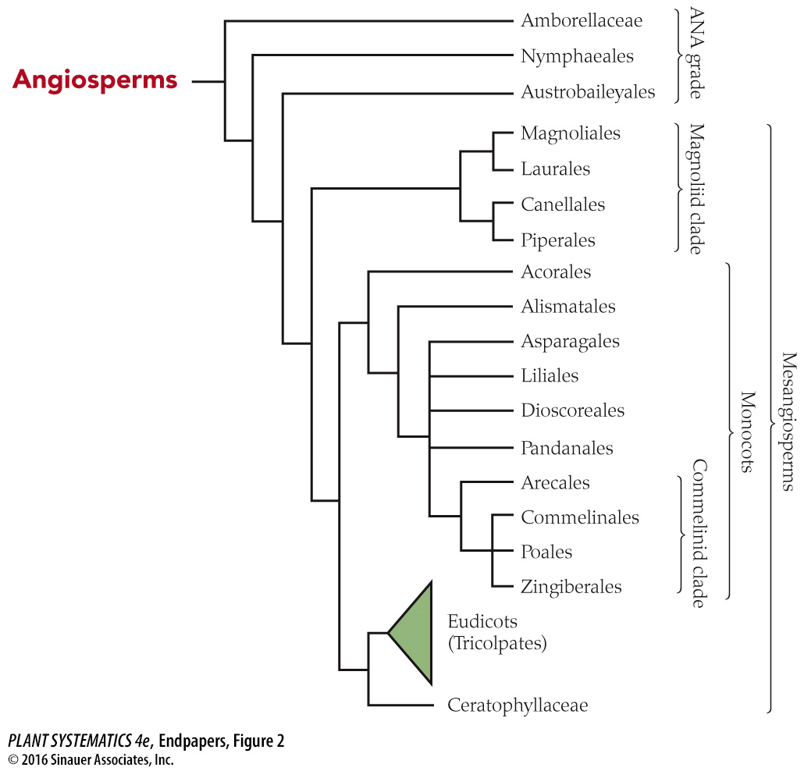
You are here!

Slide 4
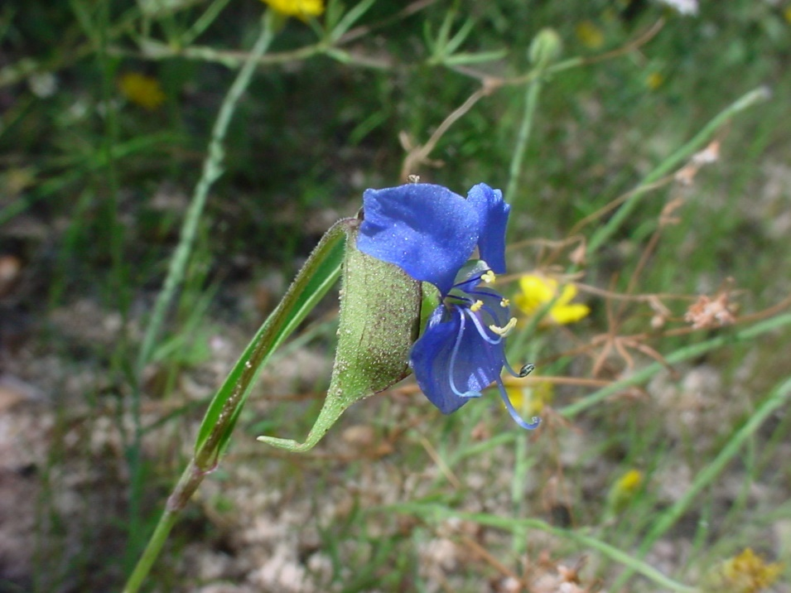
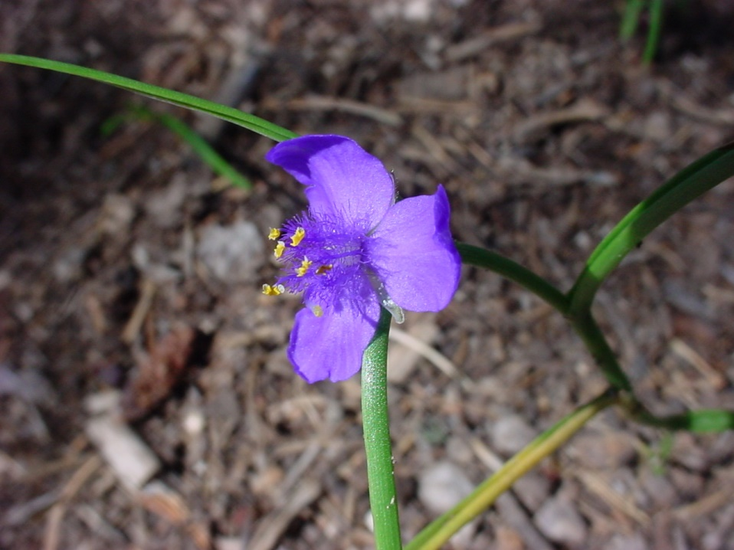
Commelinales: Commelinaceae
Commelina dianthifolia
Tradescantia pinetorum
Spathe
No spathe, hairy filaments

Slide 5
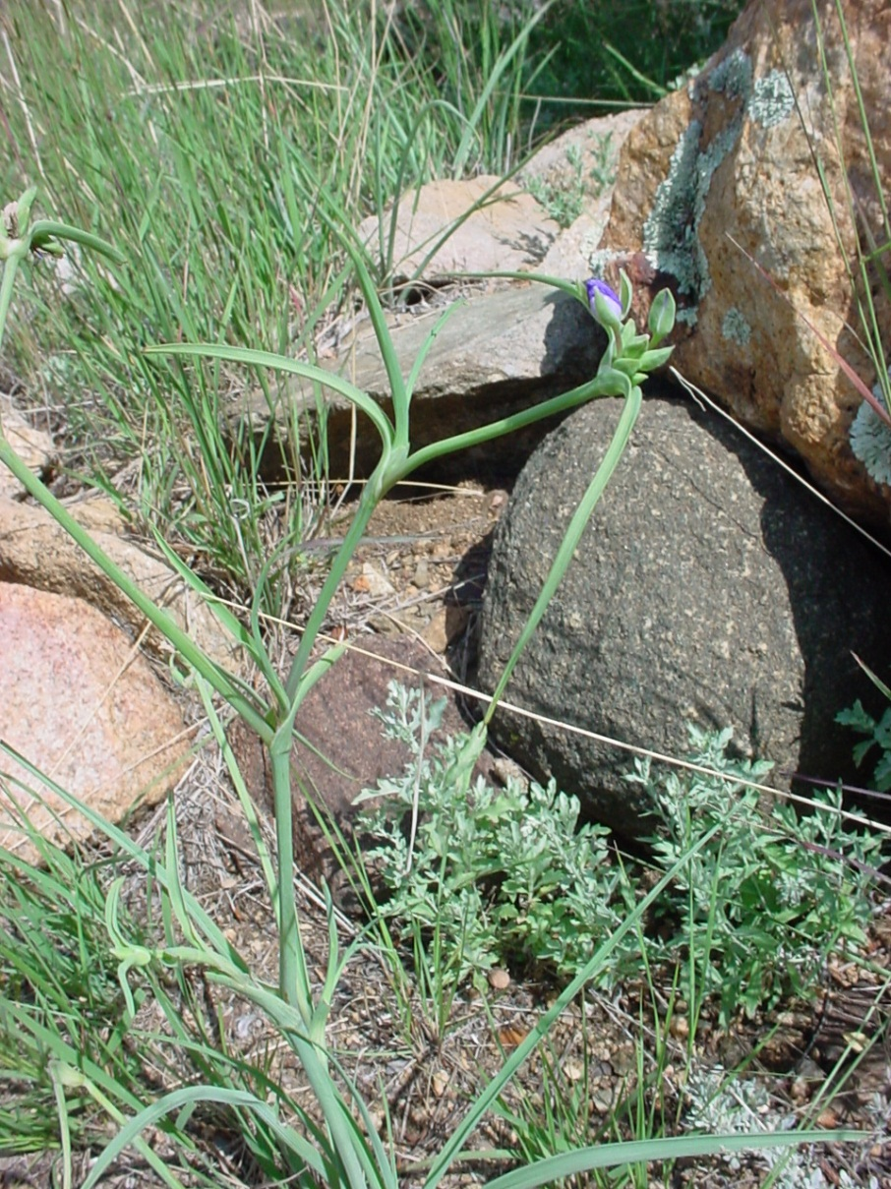
Commelinales: Commelinaceae: Tradescantia occidentalis
Leaves 2-ranked and grasslike

Slide 6
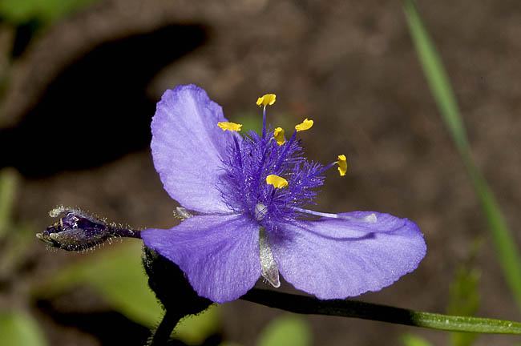
Commelinales: Commelinacea: Tradescantia pinetorum
Three sepals, three petals, 6 stamens, superior ovary. The flowers function for only a day at the most!

Slide 7
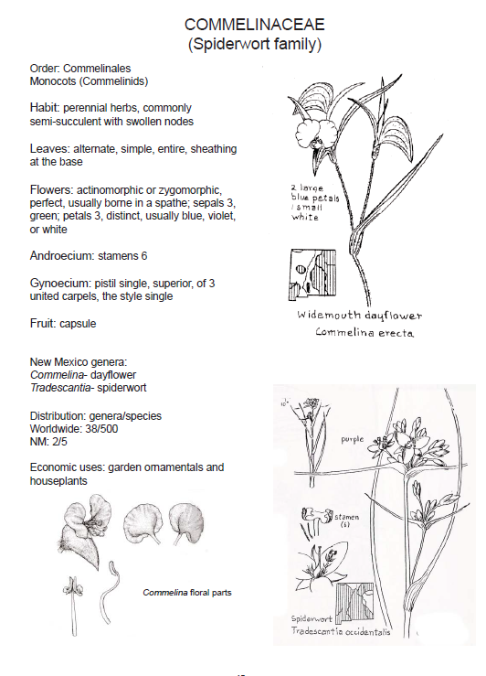

Slide 8
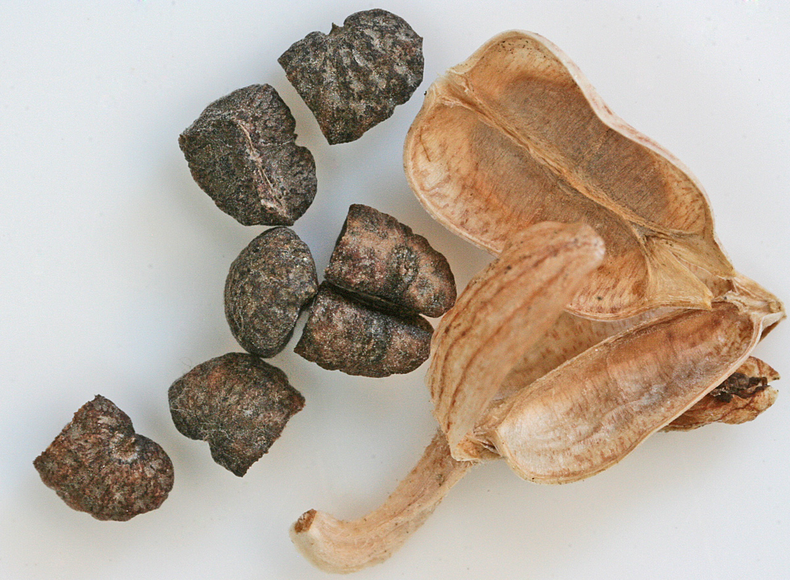
Commelina dianthifolia
Fruit is a loculicidal capsule

Slide 9
Commelinaceae
Grass like, sheathing at the base; flowers enclosed in spathe sometimes
Foliage—
Sepals—
Petals–
Androecium—
Gynoecium—
Fruit—
Three, distinct
Three distinct, usually clawed
Sometimes with conspicuous hairs (Tradescantia)
Ovary superior, 3 connate carpels
Loculicidal capsule; seeds with conspicuous conical cap, bullet shaped

Slide 10
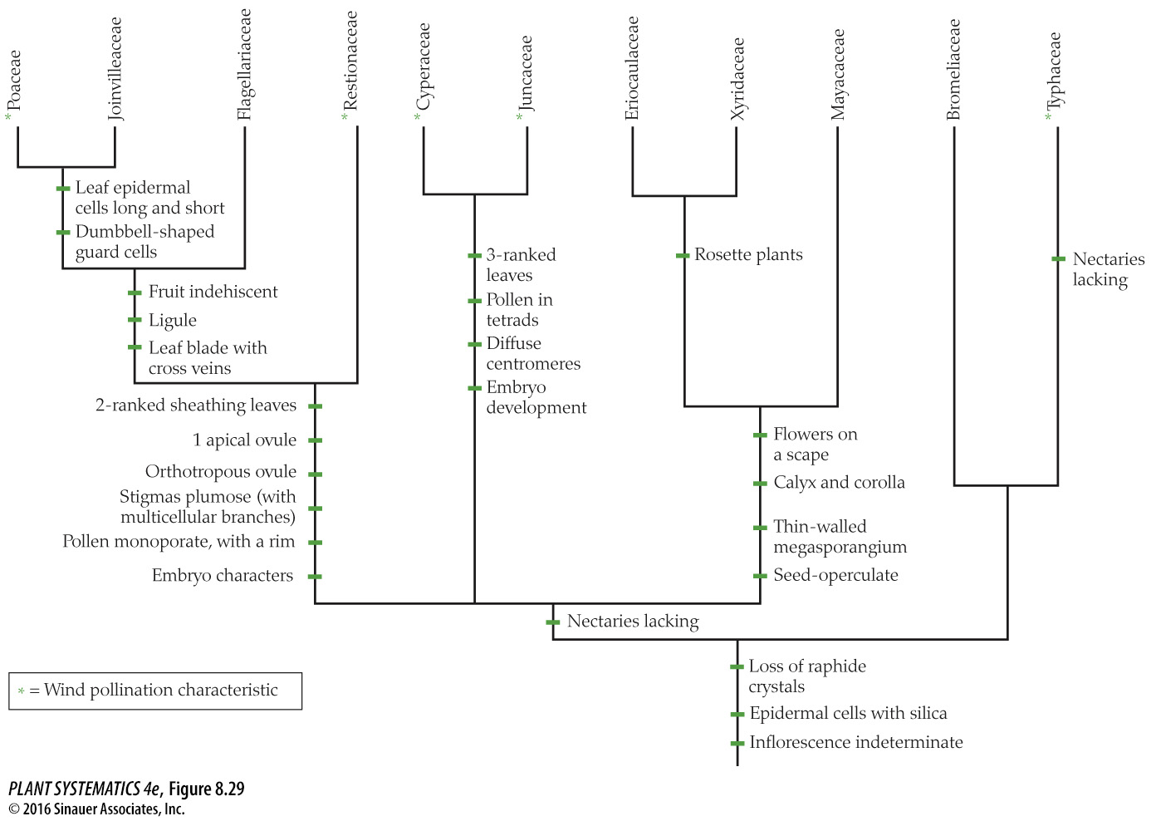
***
***
Poales
Most lack nectaries and are wind-pollinated

Slide 11
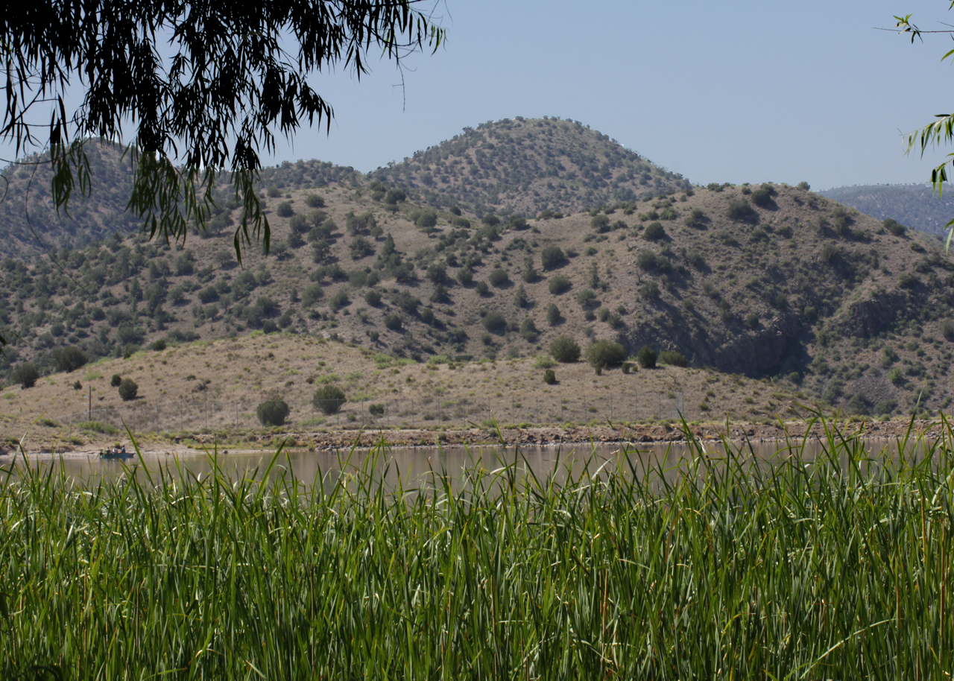
Poales: Typhaceae
Typha domingensis

Slide 12
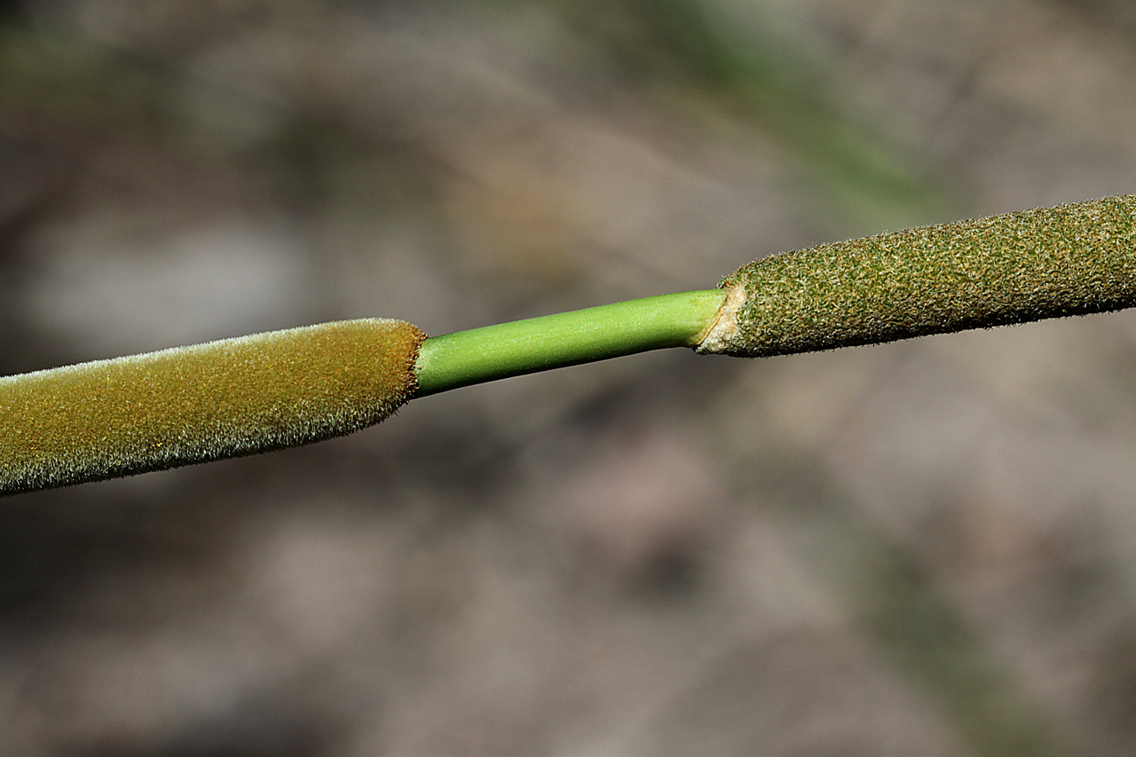
Poales: Typhaceae
Typha domingensis

Slide 13
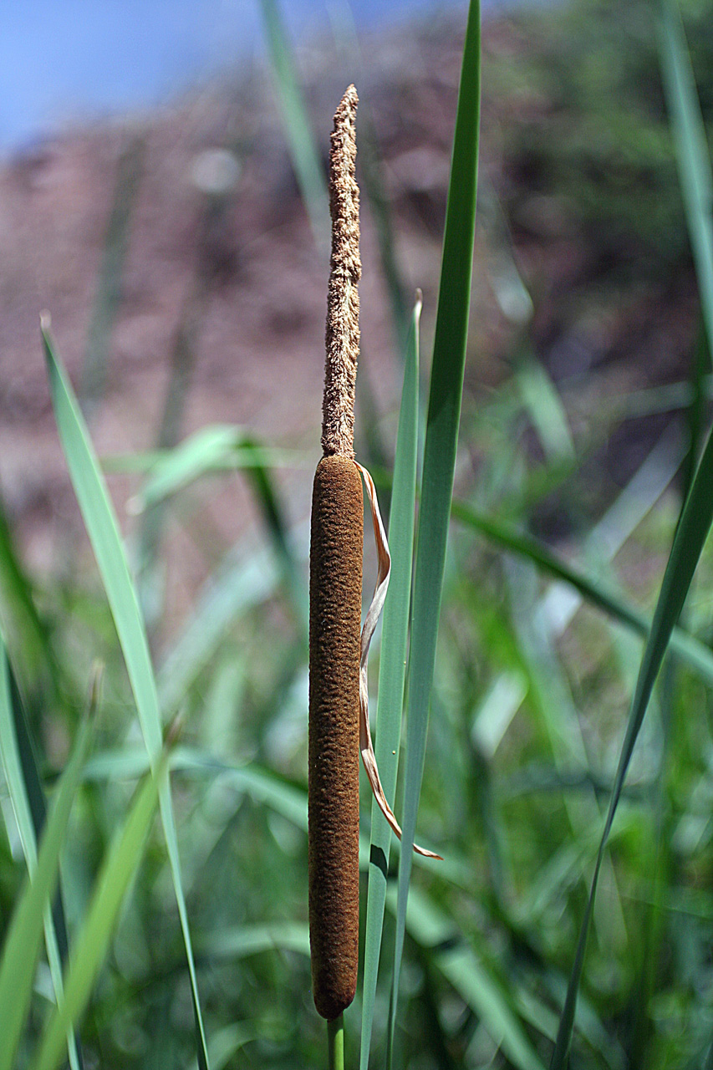
Poales: Typhaceae
Typha latifololia

Slide 14
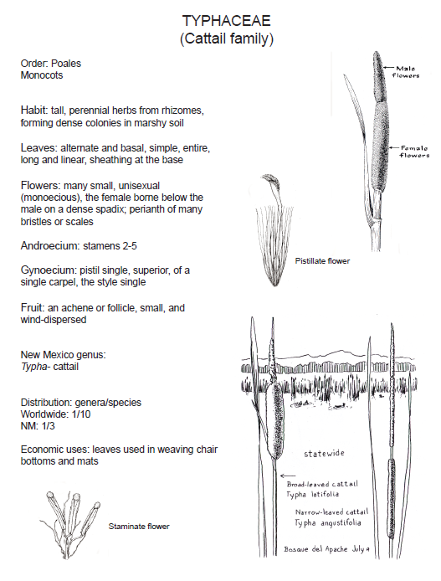

Slide 15
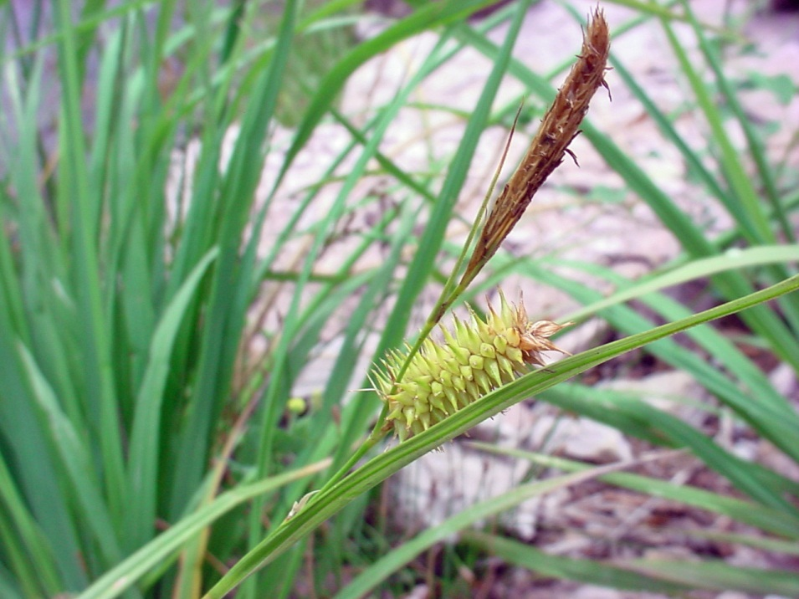
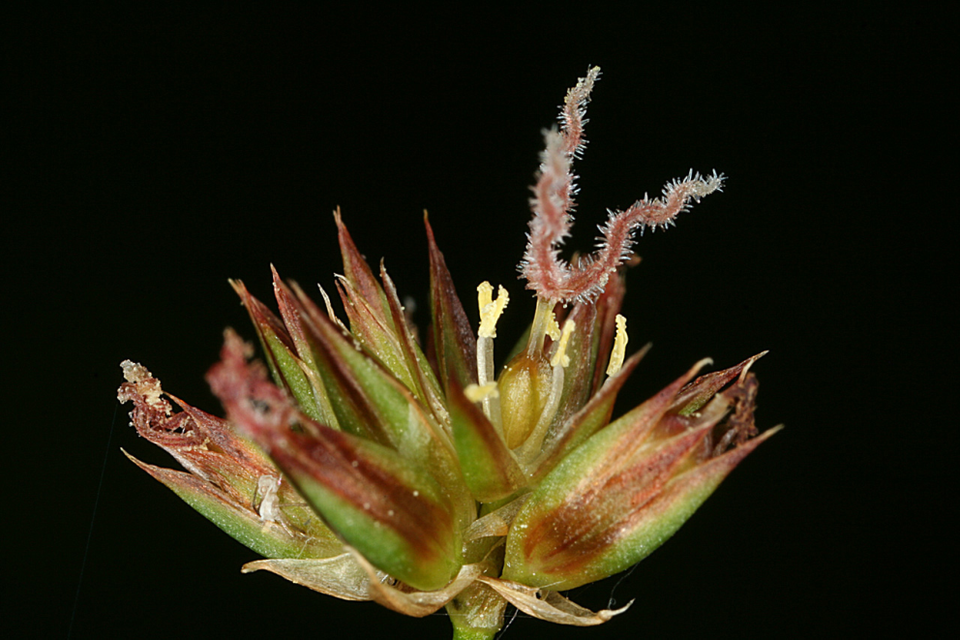
Poales
Cyperaceae: Carex hystricina
Juncaceae: Juncus ensifolius

Slide 16
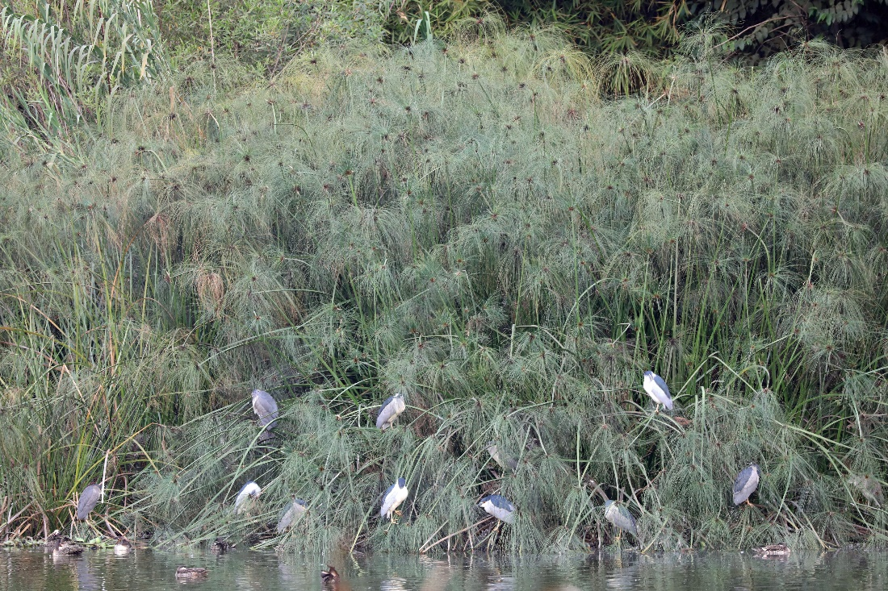
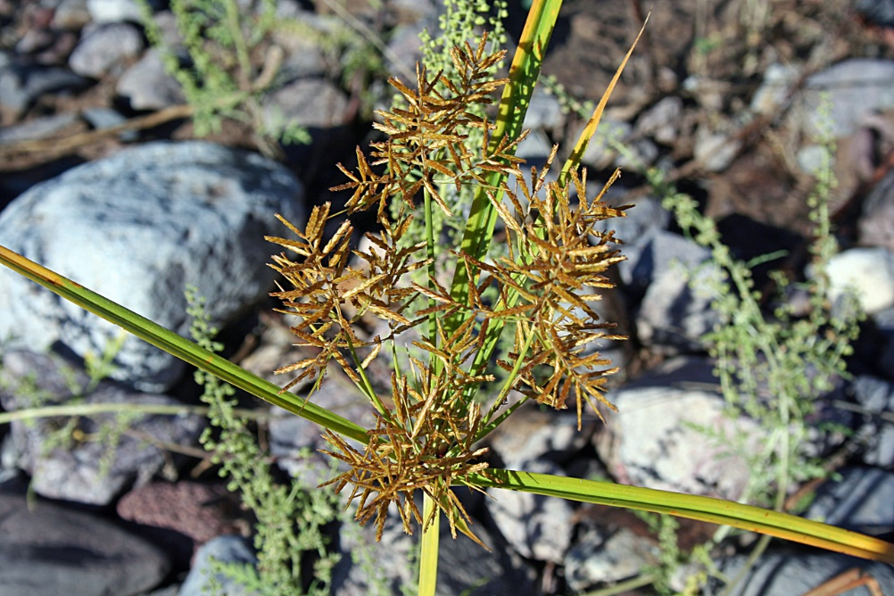
Poales: Cyperaceae: Cyperus esculentus– 3-ranked leaves
Cyperus papyrus—the stem was used to make early forms of paper!

Slide 17
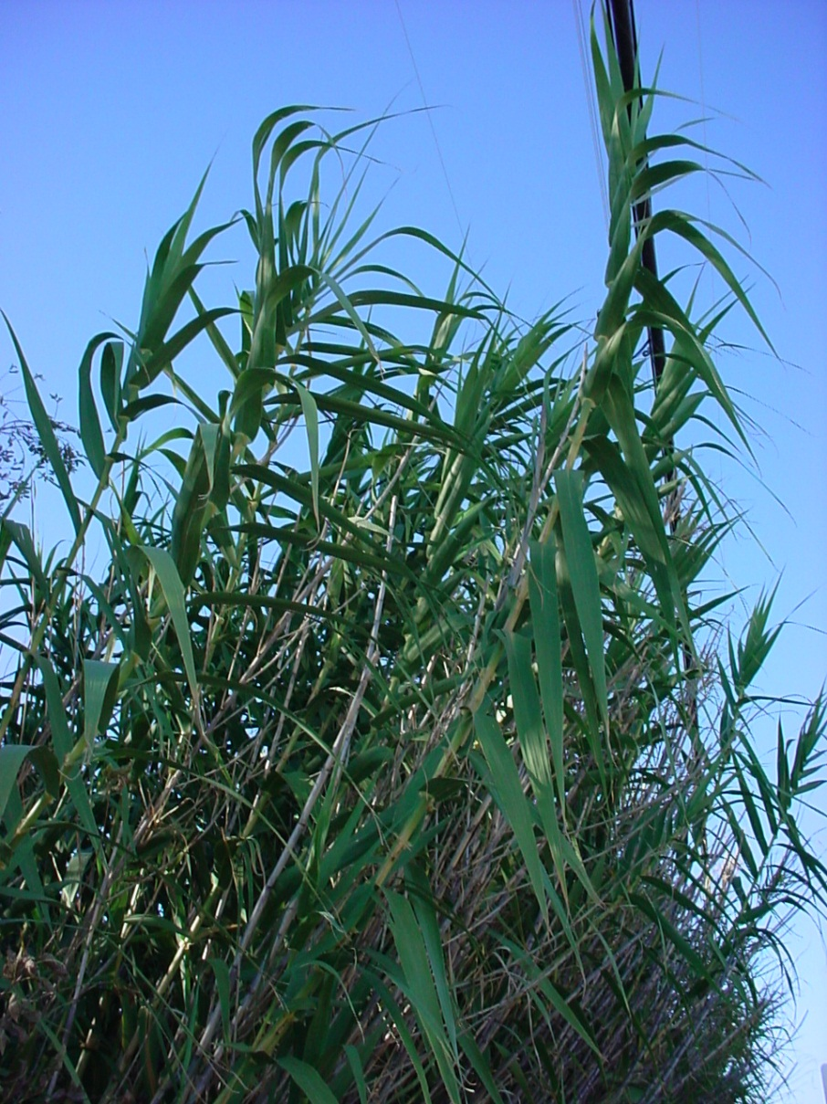
Poales: Poaceae: Arundo Donax– 2-ranked leaves

Slide 18
Commelinoid Clade: Poales: Poaceae (The Grass Family)
With thanks to Dr. Norris for many of these slides…

Slide 19
Poaceae (Grasses)
A family of extraordinary economic importance
“50% of humanities calories come from grasses” J&C pg. 300
“70% of the world’s farmland is planted in grasses” J&C pg. 300
The four most important crops are grasses: corn, wheat, rice & sugarcane

Slide 20
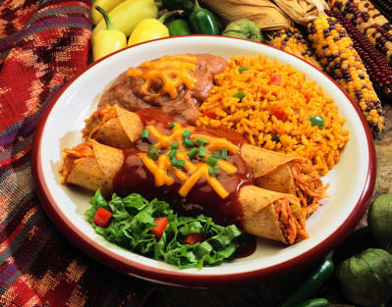
Rice
Corn
Would you like corn or wheat? Both are grasses!

Slide 21
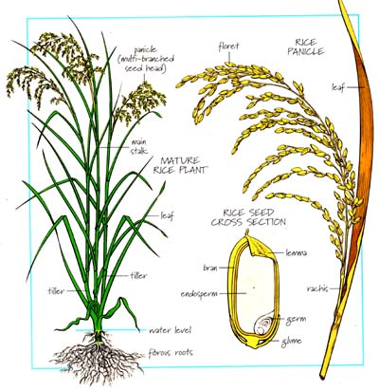
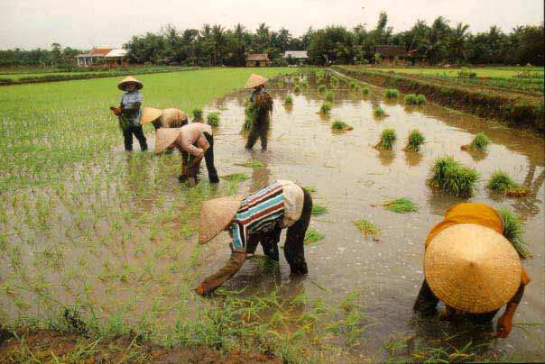
Rice (Oryza)

Slide 22
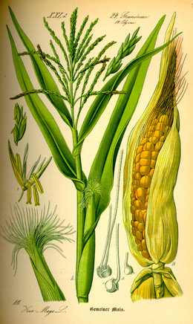
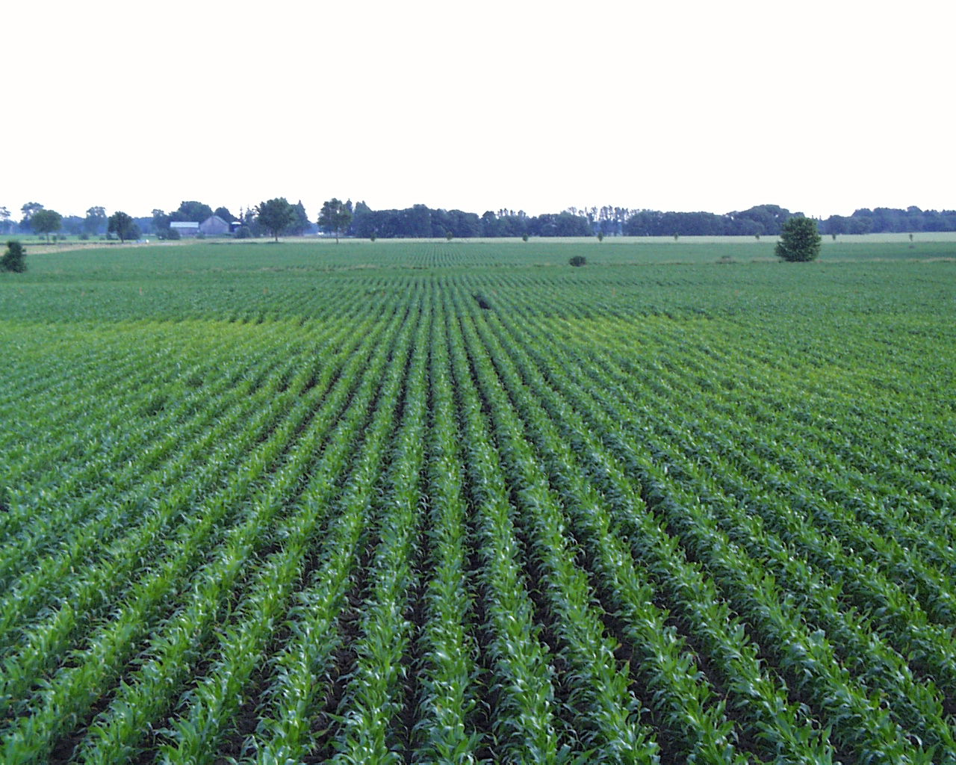
Corn (Zea)
The fruit (ear) is a multiple of caryopses!

Slide 23
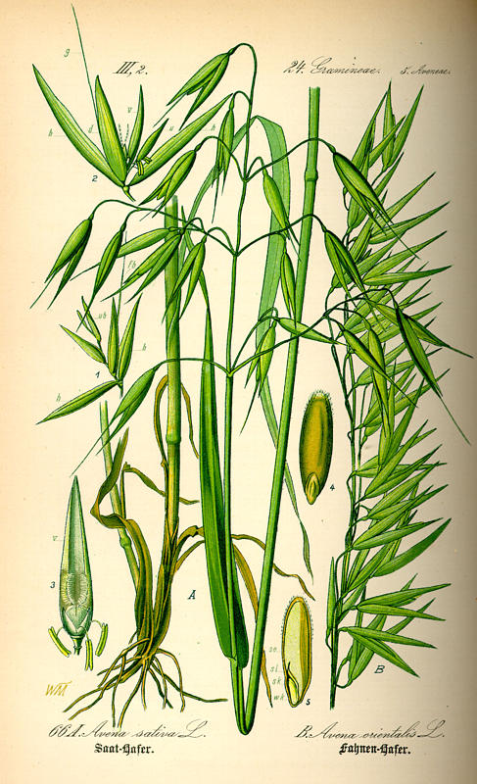
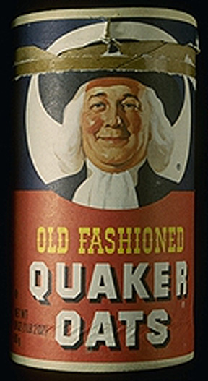
Oats (Avena)

Slide 24
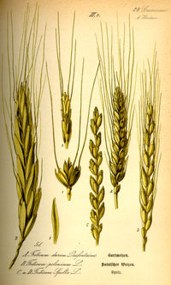
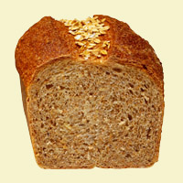
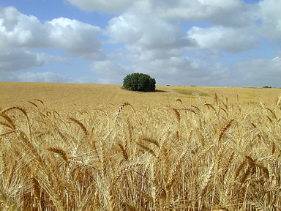
Wheat (Triticum)

Slide 25
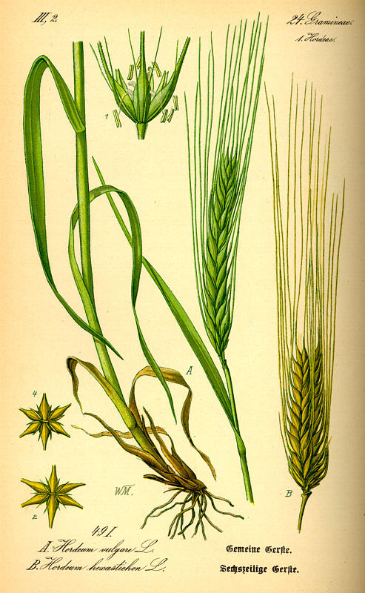
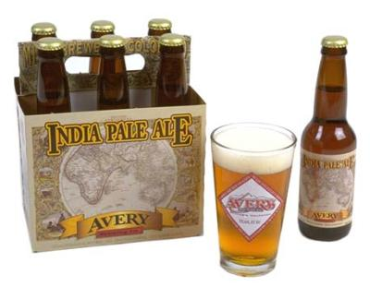
Barley (Secale)

Slide 26
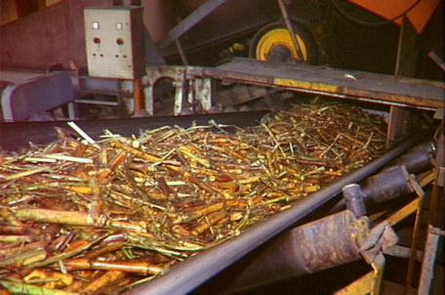
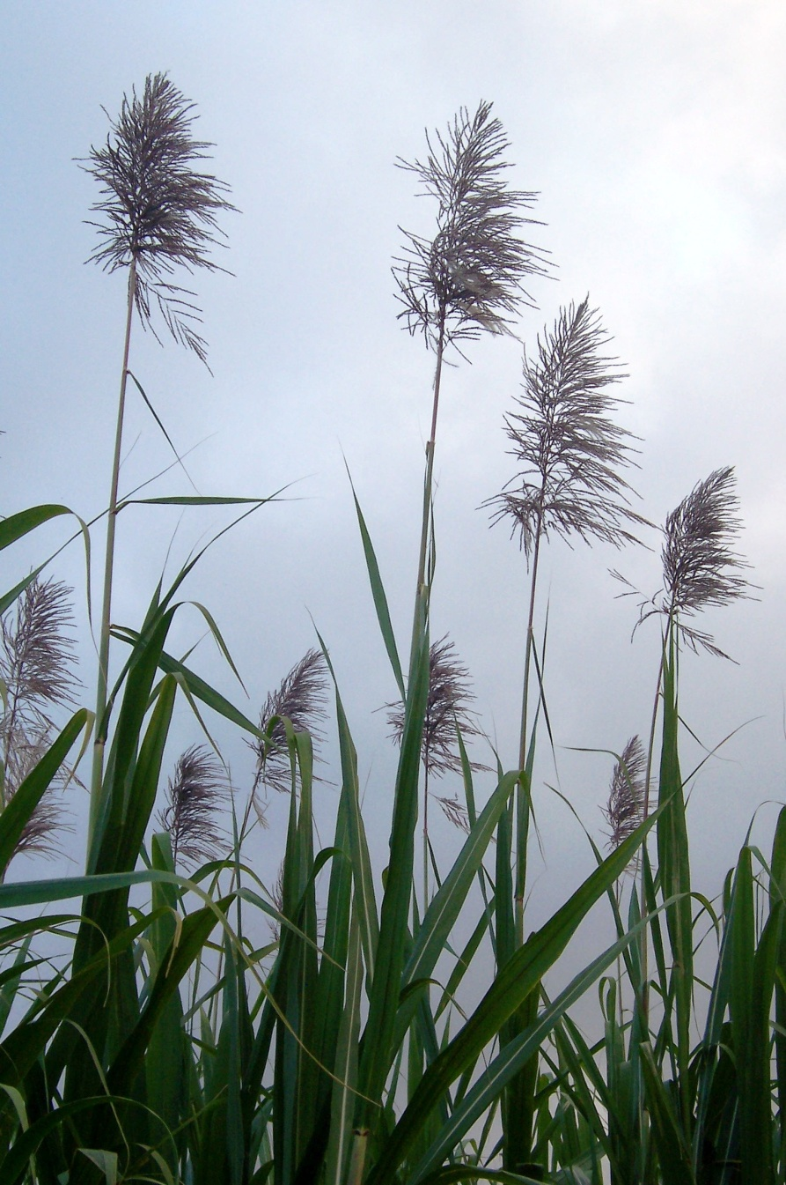
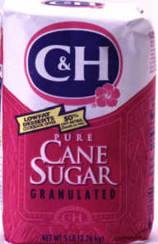
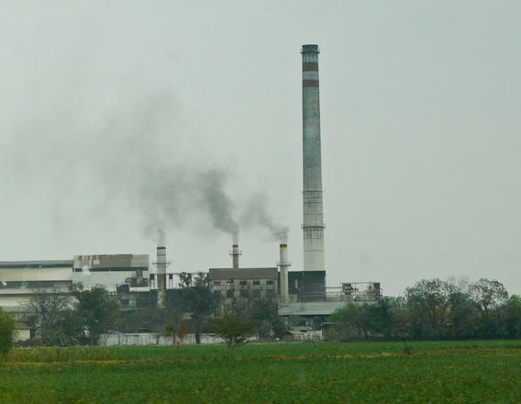
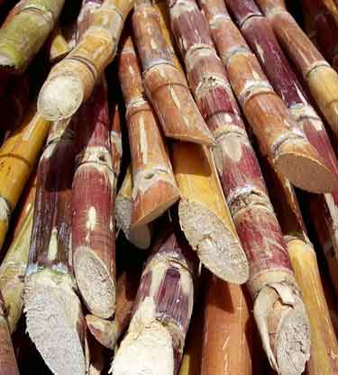
Sugar (Saccharum)

Slide 27
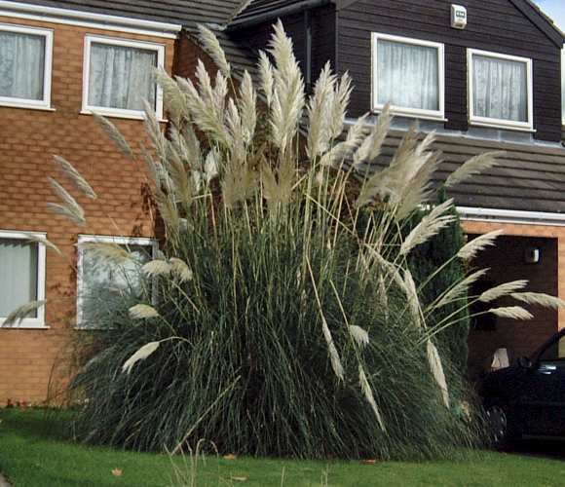
Grasses as ornamentals
Pampas Grass (Cortaderia)

Slide 28
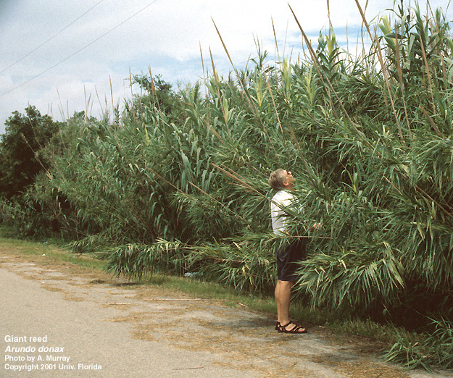
Giant Reed (Arundo)
Grasses for windbreak and erosion control

Slide 29
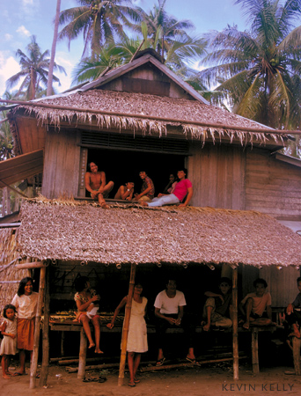
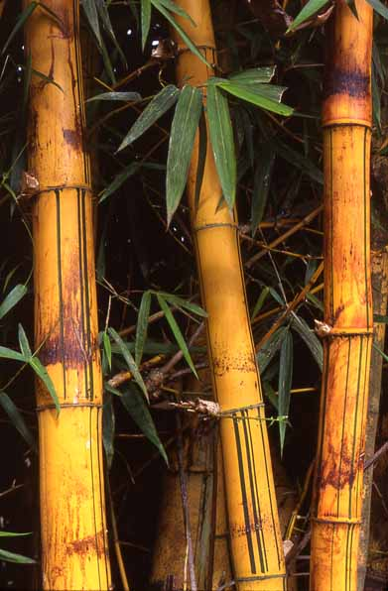
Grass (bamboo) is an important construction material in large parts of the world.

Slide 30


Grass enhances our free time recreational experience: golf, football, baseball, soccer….

Slide 31
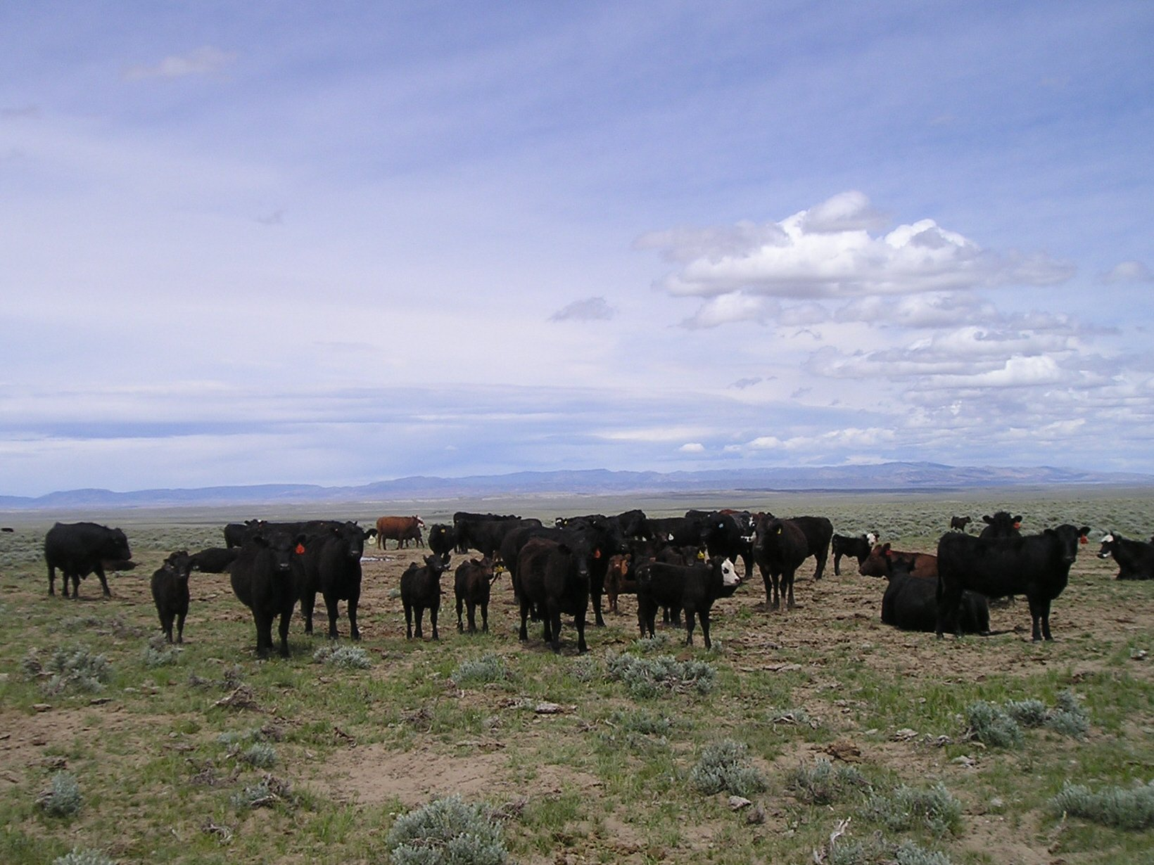
No grass, no Big Mac…

Slide 32
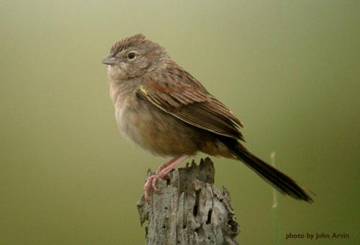
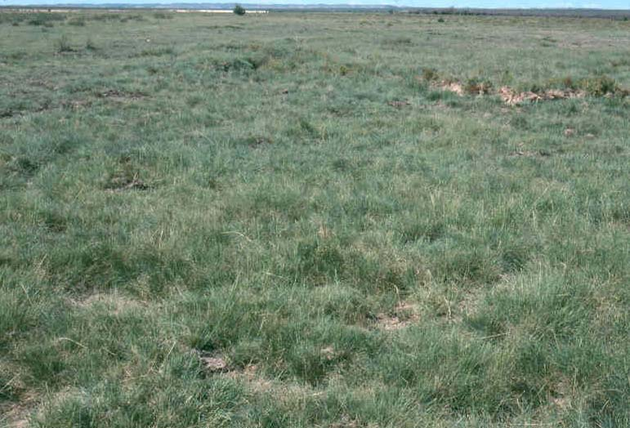
Botteri’s Sparrow
Sacaton Grass

Slide 33
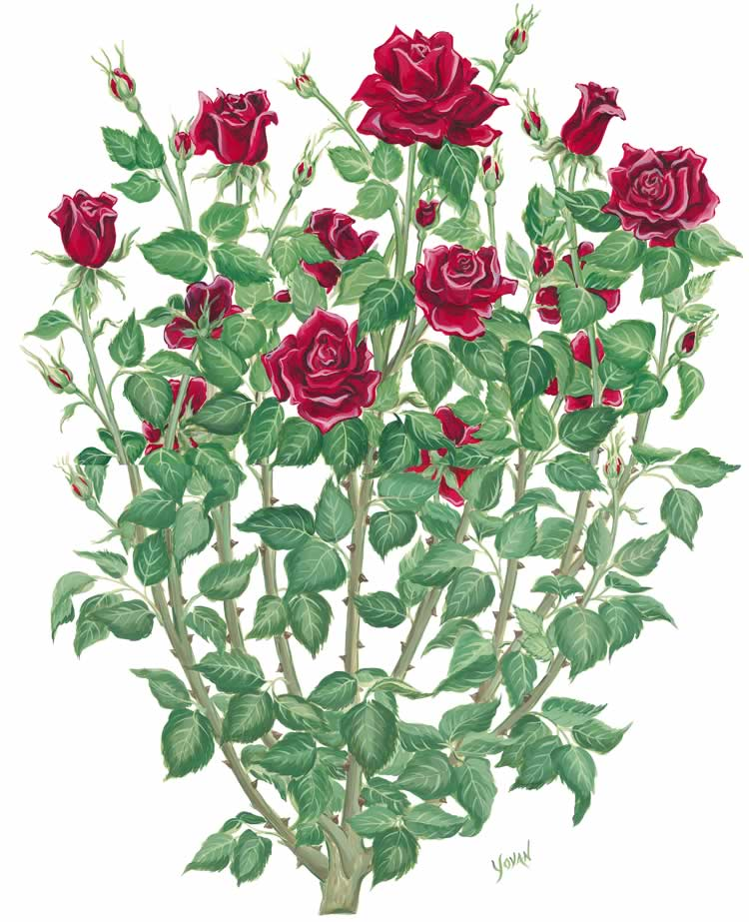
Grasses have flowers too, they just look different than this
Grasses have leaves too, they just look different than this
Grasses are flowering plants too

Slide 34
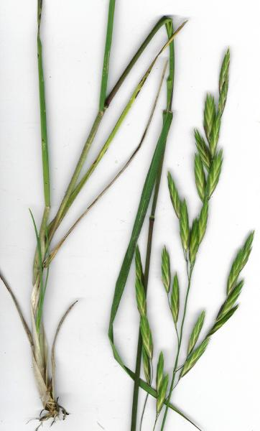
They look like this!

Slide 35
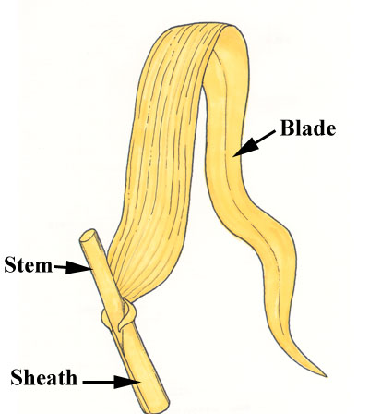
Leaf = Blade + Sheath

Slide 36


Junction of Blade and Sheath (I)
Ligule

Slide 37

Ligule

Slide 38

Junction of Blade and Sheath (II)
Auricles

Slide 39

Aerial Stems
Culm
(= Grass Stem)

Slide 40
Prostrate Stems
Above ground
As in Bermudagrass (Cynodon) as it crosses sidwalks.

Slide 41
Subterranean Stem

Slide 42


Fibrous Roots
They are also adventitious, which implies an origin other than on the radicle (embryonic root)
Fibrous roots are well branched, with the branches about equal thickness and no obvious taproot.

Slide 43
Essential Vegetative Terminology
Leaf Blade
Leaf Sheath
Ligule
Auricle
Culm
Stolon
Rhizome
Fibrous Roots

Slide 44


An inflorescence
Also an inflorescence

Slide 45
Grass Flower
3 carpels, 2 style branches and one grain per flower!
Hypogynous insertion, superior ovary!
Lodicule is reduced perianth parts of a grass flower.

Slide 46

Grass Floret
Floret = Flower Enclosed in Two Bracts (Lemma, Palea)
Bract= some form of modified leaf

Slide 47

Grass Spikelet
The rachilla is the main axis of the spikelet that bears the florets
The pedicel is the stalk to the inflorescence
Grass Spikelet = Two Glumes + Floret(s)
Glume= bract (modified leaves) at the base of a grass spikelet

Slide 48

Spikelets with One Floret

Slide 49
Spikelets with Multiple Florets

Slide 50


Special Cases
Panicoid Grasses
Andropogonid Grasses
Fertile lemma
Upper glume
Hopia obtusa
Pedicellate spikelet
Sessile spikelet
Lower glume
Sterile lemma

Slide 51
Essential Floral Terminology
Floret
Lemma
Palea
Lodicule
Rachilla
Spikelet
Glume
Pedicel

Slide 52

Inflorescence
Inflorescence = Spikelet Arrangement

Slide 53
Raceme of Spikelets
Notice the pedicels in a raceme.

Slide 54

Spike of Spikelets
(Spicate Raceme)
Spikes differ from racemes in having no pedicels to the spikelets

Slide 55

Panicle of Spikelets
Panicles are multiply branched
(Open Panicle)

Slide 56

Panicle of Spikelets
(Contracted Panicle)

Slide 57

Spike of Spikes
(Spike of Spicate Branches)
Each one of these is a spikelet made up of multiple florets
Hairy Grama (Bouteloua hirsuta)

Slide 58
Essential Inflorescence Terminology
Raceme
Spike
Panicle (Including Contracted Panicle)
Spike of Spikes

Slide 59


Some Grasses use the C3 photosynthetic pathway (cool season grasses) and some use the C4 pathway (warm season grasses)
C3 pathway
C4 pathway

Slide 60


C3 & C4 Photosynthesis– Kranz Anatomy
C3– Bromus catharticus
C4– Aristida purpurea
At 86° F C4 becomes more efficient than C3 due to photorespiration

Slide 61
“Since every CO2 molecule has to be fixed twice, first by 4-carbon organic acid and second by RuBisCO, the C4 pathway uses more energy than the C3 pathway. The C3 pathway requires 18 molecules of ATP for the synthesis of one molecule of glucose, whereas the C4 pathway requires 30 molecules of ATP. This energy debt is more than paid for by avoiding losing more than half of photosynthetic carbon in photorespiration as occurs in some tropical plants, making it an adaptive mechanism for minimizing the loss.”
--quoted from that ubiquitous source, Wikipedia

Slide 62
Poaceae
More than 100 grasses in the Gila
Muhlenbergia is the largest grass genus in the Gila– one floret per spikelet
J&C states on page 297 that the grass floret has three carpels that often appear as 2. But there is only one locule and one ovule. The fruit of each flower is a single seeded caryopsis (grain). What’s going on here? Hint: scientists are still arguing about this…

Slide 63


